Slide 1
OpenMP Temelleri

Slide 2
What is OpenMP
OpenMP is an API designed for programming shared memory parallel computers
OpenMP uses the concepts of threads
OpenMP is a set of extensions to C, C++ and Fortran
The extensions consist of:
  Compiler directives
  Runtime library routines
  Environment variables

Slide 3
Directives and Sentinels
A directive is a special line of source code with meaning only to certain compilers
A directive is distinguished by a sentinel at the start of the line
OpenMP sentinels are:
  C / C++: #pragma omp
  Fortran : !$OMP
This means that OpenMP directives are ignored if the code is compiled as regular sequential C/C++/Fortran

Slide 4
Parallel Region
The parallel region is the basic parallel construct in OpenMP
A parallel region defines a section of a program
Program begins execution on a single thread (the master thread)
When the first parallel region is encountered, master thread creates a team of threads (fork/join model)
Every thread executes the statements which are inside the parallel region
At the end of the parallel region, the master thread waits for the other threads to finish, and continues executing the next statements

Slide 5
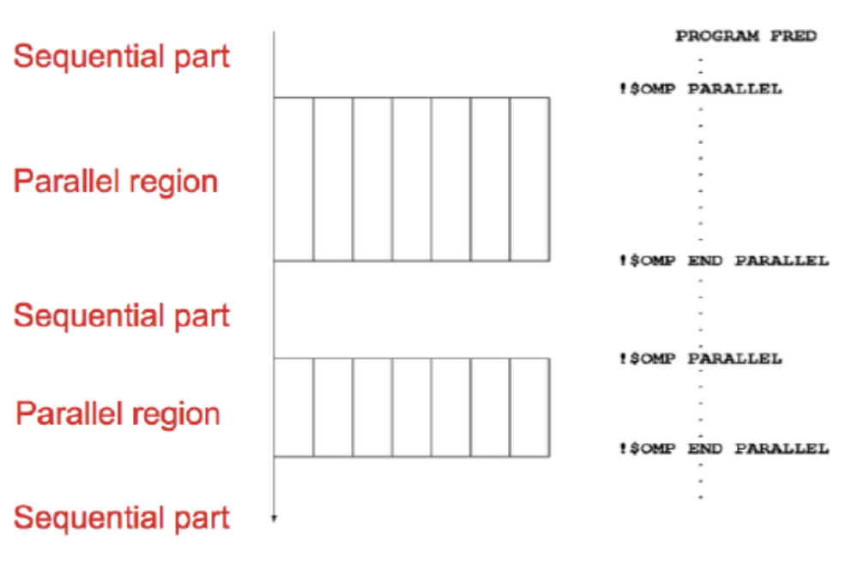
Parallel Region

Slide 6
Shared and Private Data
Inside a parallel region, variables can either be shared or private
All threads see the same copy of shared variables
All threads can read or write shared variables
Each thread has its own copy of private variables: these are invisible to other threads
A private variable can only be read or written by its own thread

Slide 7
Parallel Loops
In a parallel region, all threads execute the same code
OpenMP has also directives which indicate that work should be divided up between threads, not replicated
  this is called worksharing
Since loops are the main source of parallelism in many applications, OpenMP has an extensive support for parallelising loops
There are a number of options to control which loop iterations are executed by which threads
It is up to programmer to ensure that the iterations of a parallel loop are independent
Only loops where the iteration count can be computed before the execution of the loop begins can be parallelised in this way

Slide 8
Synchronisation
The main synchronisation concepts used in OpenMP are:
Barrier
  all threads must arrive at a barrier before any thread can proceed past it
  e.g. delimiting phases of computation
Critical regions
  a section of code which only one thread at a time can enter
  e.g. modification of shared variables
Atomic update
  an update to a variable which can be performed only by one thread at a time
  e.g. modification of shared variables (special case)

Slide 9
Brief History of OpenMP
Historical lack of standardisation in shared memory directives
  each hardware vendor provided a different API
  mainly directive based
  almost all for Fortran
  hard to write portable code
OpenMP forum is set up by Digital, IBM, Intel, KAI and SGI. Now includes most major vendors (and some academic organisations)
OpenMP Fortran standard released in October 1997, minor revision (1.1) in November 1999, Major revision (2.0) in November 2000
OpenMP C/C++ standard released October 1998. Major revision (2.0) in March 2002

Slide 10
History (cont.)
Combined OpenMP C/C++/Fortran standart (2.5) released in May 2005
  no new features, but extensive rewriting and clarification
Version 3.0 released in May 2008
  new features, including tasks, better support for loop parallelism and nested parallelism
Version 3.1 released in June 2011
  corrections and some minor new features
  most current compilers support this
Version 4.0 released in July 2013
  accelerator offloading, thread affinity, more task support
  now appearing in implementations
Version 4.5 released in November 2015
  corrections and a few new features

Slide 11
Compiling and Running OpenMP Programs
OpenMP is built-in to most of the compilers you are likely to use
To compile OpenMP program you need to add a (compiler-specific) flag to your compile and link commands
  -fopenmp for gcc/gfortran
  -openmp for Intel compilers
The number of threads which will be used is determined at runtime by OMP_NUM_THREADS environment variable
  set this before you run the program
  e.g. export OMP_NUM_THREADS=4
Run in the same way you would a sequential program
  type the name of the executable

Slide 12
Exercise
“Hello World” program
Aim: to compile and run a trivial OpenMP program
Vary the number of threads using the OMP_NUM_THREADS environment variable
Run the code several times. Is the output always the same?

Slide 13
Parallel Regions
Code within a parallel region is executed by all threads
Syntax:
C/C++:
  #pragma omp parallel
{
block
}
Fortran: !$OMP PARALLEL
block
!$OMP END PARALLEL

Slide 14
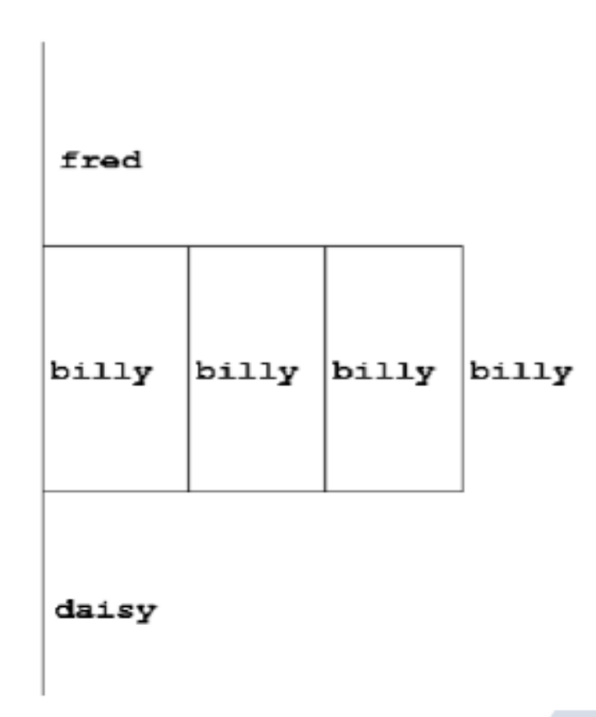
Parallel Region Directive (cont.)
fred();
#pragma omp parallel
{
billy();
}
daisy();

Slide 15
Useful Functions
Often useful to find out number of threads being used
Fortran:
USE OMP_LIB
INTEGER FUNCTION OMP_GET_NUM_THREADS()
C/C++:
#include <omp.h>
int omp_get_num_threads(void);
Note: returns 1 if called outside parallel region!

Slide 16
Clauses
Specify additional information in the parallel region directive through clauses:
C/C++: #pragma omp parallel [clauses]
Fortran: !$OMP PARALLEL [clauses]
Clauses are comma or space separated in Fortran, space separated in C/C++

Slide 17
Shared and Private Variables
Inside a parallel region, variables can be either shared (all threads see same copy) or private (each thread has its own copy)
shared, private and default are OpenMP
clauses
C/C++:
Fortran:
shared(list)
private(list)
default(shared|none)
SHARED(list)
PRIVATE(list)
DEFAULT(SHARED|PRIVATE|NONE)

Slide 18
Shared and Private (cont.)
On entry to a parallel region, private variables are uninitialised
Variables declared inside the scope of the parallel region are automatically private
After the parallel region ends, the original variable is unaffected by any changes to private copies
Not specifying a DEFAULT clause is the same as specifying DEFAULT(SHARED)
Danger!
Always use DEFAULT(NONE)

Slide 19
Shared and Private (cont.)
Example: each thread initializes its own column of a shared array
!$OMP PARALLEL DEFAULT (NONE), PRIVATE (I, MYID),
!$OMP& SHARED(A,N)
MYID = OMP_GET_THREAD_NUM() + 1
DO I = 1, N
A(I, MYID) = 1.0
END DO
!$OMP END PARALLEL

Slide 20
Multi-line Directives
C/C++:
#pragma omp parallel default(none) \
private(i,myid) shared(a,n)
Fortran: fixed source form
!$OMP PARALLEL DEFAULT(NONE), PRIVATE(I,MYID),
!$OMP& SHARED(A,N)
Fortran: free source form
!$OMP PARALLEL DEFAULT(NONE), PRIVATE(I,MYID), &
!$OMP SHARED(A,N)

Slide 21
Initializing Private Variables
Private variables are uninitialized at the start of the parallel region
If we wish to initialize them, we use FIRSTPRIVATE
clause:
C/C++: firstprivate(list)
Fortran: FIRSTPRIVATE(list)

Slide 22
Initializing Private Variables (cont.)
b = 23.0;
. . . . .
#pragma omp parallel firstprivate(b),
private(i, myid)
{
myid = omp_get_thread_num();
for (i=0; i<n; i++) {
b += c[myid][i];
}
c[myid][n] = b;
}

Slide 23
Reductions
A reduction produces a single value from associative operations such as addition, multiplication, max, min, and, or
Would like each thread to reduce into a private copy, then reduce all these to give final result
Use REDUCTION clause:
C/C++: reduction(op: list)
Fortran: REDUCTION(op: list)
Can have reduction arrays in Fortran, but not in C/C++

Slide 24
Reductions (cont.)
B = 10
!$OMP PARALLEL REDUCTION (+:B),
!$OMP& PRIVATE(I, MYID)
MYID = OMP_GET_THREAD_NUM() + 1
DO I = 1, N
B = B + C[I][MYID]
END DO
!$OMP END PARALLEL
A = B

Slide 25

Exercise
Area of the Mandelbrot set
Aim: introduction to using parallel regions
Estimate the area of the Mandelbrot set by Monte Carlo sampling
Generate a grid of complex numbers in a box surrounding the set
Test each number to see if it is in the set or not
Ratio of points inside a total number of points gives an estimate of the area
Testing of points is independent - parallels with a parallel region

Slide 26
Worksharing
Directives which appear inside a parallel region and indicate how work should be shared out between threads are
  Parallel DO/for loops
  Single directive
  Master directive

Slide 27
Parallel DO/for Loops
Loops are the most common source of parallelism in most codes. Therefore, parallel loop directives are vey important!
A parallel DO/for loop divides up the iterations of the loop between threads
The loop directive appears inside a parallel region and indicates that the work should be shared out between threads, instead of replication
There is a synchronisation point at the end of the loop: all threads must finish their iterations before any thread can proceed

Slide 28
Parallel DO/for Loops (cont.)
Syntax:
Fortran: !$OMP DO [clauses]
DO loop
!$OMP END DO
C/C++:
#pragma omp for [clauses]
for loop

Slide 29
Restrictions in C/C++
Because the for loop in C is a general while loop, there are restrictions on the form it can take
It has two determinable trip count - it must be of the form
for (var = a; var logical-op b; incr-exp)
where logical-op is one of <, <=, >, >=
and incr-exp is var = var +/- incr or semantic
equivalent such as var++
also can not modify var within the loop body

Slide 30
Parallel Loops (Example)
!$OMP PARALLEL
!$OMP DO
DO i=1,n
b(i)=(a(i)-a(i-1))*0.5
END DO
!$OMP END DO
!$OMP END PARALLEL
#pragma omp parallel
{
#pragma omp for
for (int i=1, i<=n, i++) {
b(i)=(a(i)-a(i-1))*0.5;
}
}

Slide 31
Parallel DO/for Directive
This construct is common that there is shorthand form which combines parallel region and DO/for loops
C/C++:
#pragma omg parallel for [clauses]
for loop
Fortran:
!$OMP PARALLEL DO [clauses]
do loop
!$OMP END PARALLEL DO

Slide 32
Clauses
DO/for directive can take PRIVATE, FIRSTPRIVATE and
REDUCTION clauses which refer to the scope of the loop
Note that the parallel loop variable is PRIVATE by default
loop indices are private by default in Fortran, but not in C
PARALLEL DO/for directive can take all clauses available for PARALLEL directive
PARALLEL DO/for is not the same as DO/for or the same as PARALLEL

Slide 33
Parallel DO/for Loops (cont.)
With no additional clauses, the DO/for directive will partition the iterations as equally as possible between the threads
However this is implementation dependent, and there is still some ambiguity
e.g. 7 iterations, 3 threads. Could partition as 3+3+1 or 3+2+2

